Slide 1
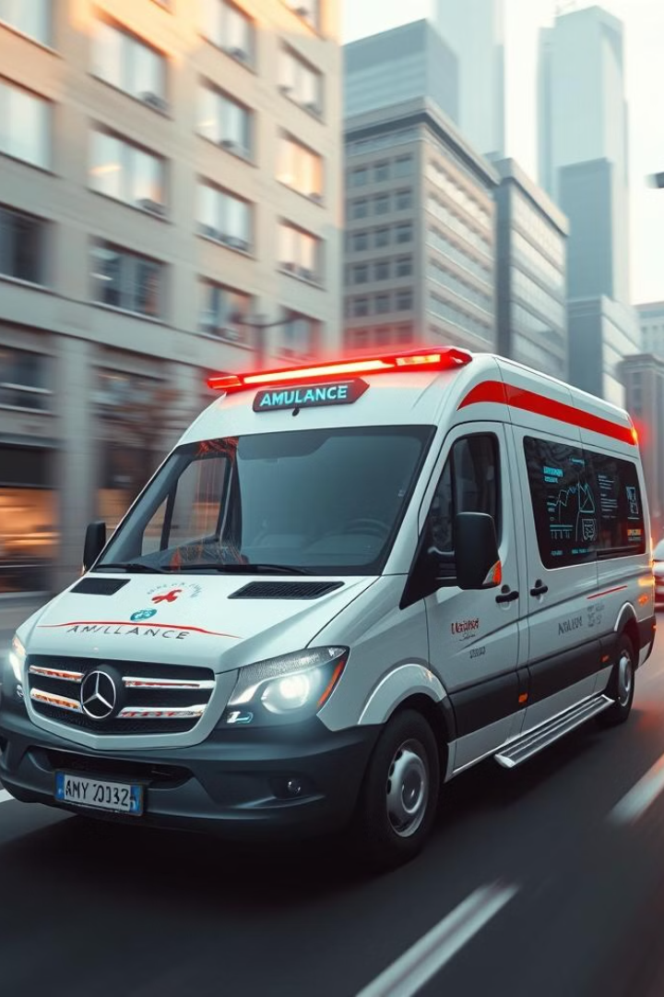
RapidResponse: Revolutionizing Emergency Medical Services
Introducing RapidResponse: A tech-driven solution for faster, more efficient ambulance services. Leveraging real-time data and smart technology to save lives. Our goal is to reduce emergency response times and improve patient outcomes. Every minute counts in emergencies; RapidResponse aims to reduce response times by 30%.

Slide 2
The Problem: Critical Delays in Emergency Response
Current ambulance dispatch systems face challenges like traffic congestion. Average city traffic delays ambulance arrival by 30-40 minutes.
Dispatchers lack visibility into ambulance location and route. Hospitals often lack advance notice for specialized equipment needs.
Families experience stress and anxiety due to lack of information. Delayed ambulance arrival correlated with a 22% increase in mortality for cardiac arrest patients.

Slide 3

Our Solution: RapidResponse App Ecosystem
1
Taxi-based Dispatch
2
Real-time Tracking
Utilizes a network of readily available ola/uber as ambulances having live support, similar to ride-sharing apps.
GPS-enabled tracking for dispatchers and family members.
3
Smart Route Optimization
4
Automated Notifications
Real-time traffic data to suggest the fastest routes.
Notifies hospitals and traffic police. Facial recognition ensures secure notifications to family members.

Slide 4




Tech Stack: Scalable and Reliable Infrastructure
React : Web based Application
SqLite: flexible, SQL database for patient and past ride records
AWS: Amazon Web Services for scalability, reliability, and security.

Slide 5
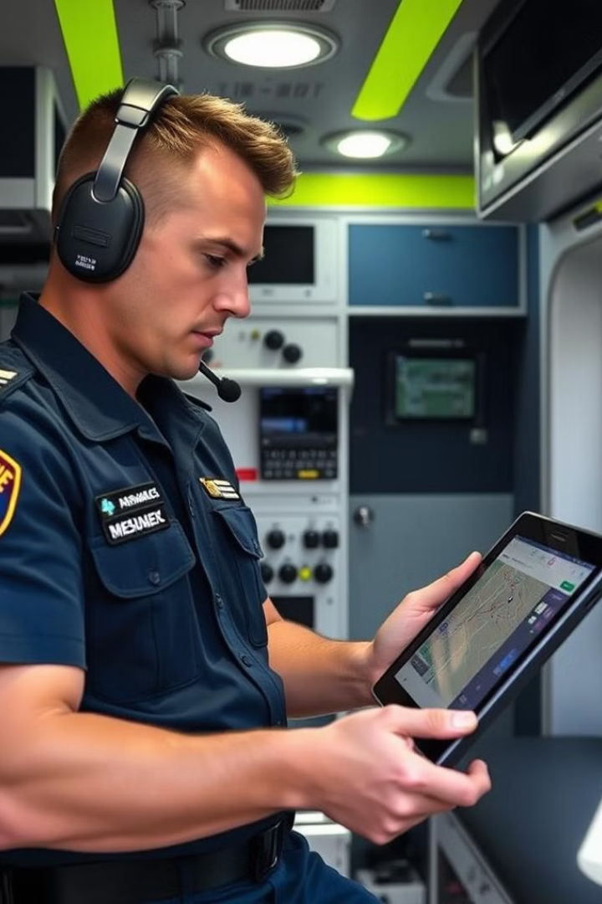




Key Features in Detail
Live Ride Tracking
Shows ambulance location, ETA, and route on a map.
Traffic Police Notification
Alerts traffic authorities in real-time for route management, reducing delays.
Hospital Notification
Sends patient information and required equipment list in advance.
Family Notification
Facial recognition ensures privacy and security for patient data.

Slide 6

Implementation Plan: Phased Rollout
Phase 1
1
Pilot program in one city district with 10 ambulances. Key Metric: Achieve a 20% reduction in response times.
2
Phase 2
Expansion to entire city with 50 ambulances. Key Metric: Reduce response times city-wide by 25%.
Phase 3
3
Integration with regional hospitals and traffic authorities. Key Metric: Reduce mortality rates in target emergencies by 10%.
4
Phase 4
Continuous improvement based on user feedback and data analysis.

Slide 7
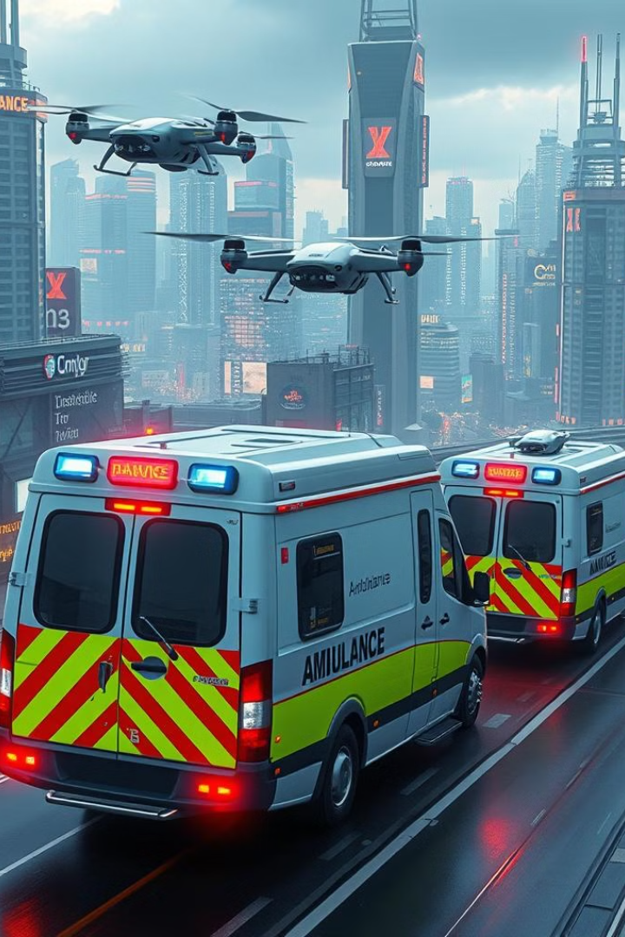
Scalability & Future Prospects
Scalability
Future Enhancements
Tech stack supports scaling to multiple cities and regions.
AI-powered predictive analytics for proactive ambulance placement.
Market Potential
Global emergency medical services market projected to reach $35 billion by 2025.

Slide 8

RapidResponse
Conclusion: Join the RapidResponse Revolution
RapidResponse offers a transformative solution for emergency medical services. Save lives by reducing response times, improving hospital preparedness, and keeping families informed.
Let's build a future where every second counts and every life is saved.

